Slide 1
NFC to SERIAL READER
Assembling manual

Slide 2
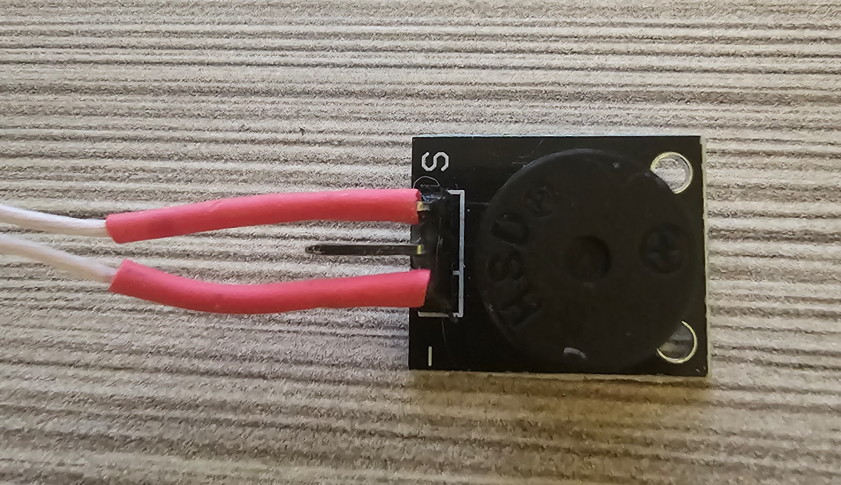
1. Wiring
Wiring notes:
The optimum wire length is ~3 inches.
Use thermal shrinking tubes (if it’s possible) to protect places of soldering to metal connectors:

Slide 3
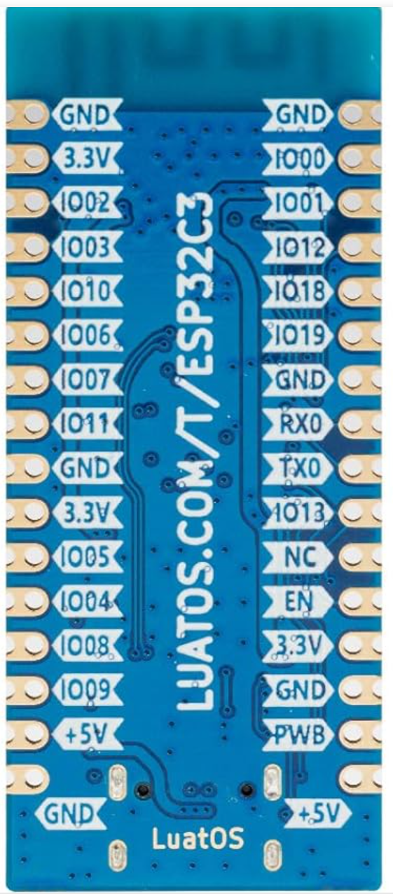
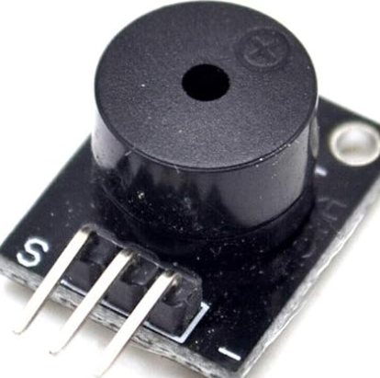
1.1. Buzzer
ESP32 Buzzer
GND -> - (Minus)
IO17 -> S (Signal)

Slide 4
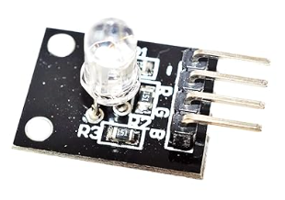
1.2. RGB LED
ESP32 RGB LED
GND -> - (Minus)
IO4 -> R
IO5 -> G
IO16 -> B

Slide 5
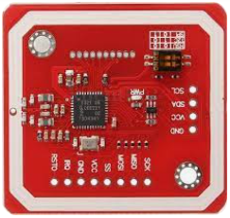
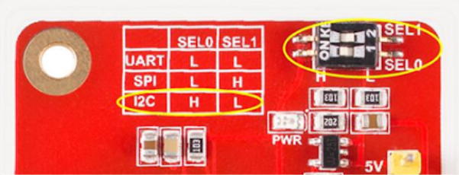
1.3. PN532
Solder wires on this side, the bottom side should be as flat as possible for better fitting in the housing
ESP32 PN532
GND -> GND
5V -> VCC
SDA -> SDA
SCL -> SCL
Set jumpers for i2c mode

Slide 6
2. Upload and test the firmware

Slide 7
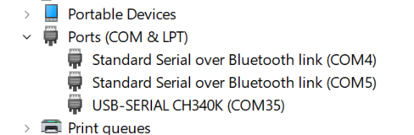
2.1. Check the USB COM port driver
Check if the device occurs in the COM&LPT ports list;
The model of the USB-Serial converter (CH340K) and the port number (COM35) may vary depending on the ESP32 board model.
Remember the COM port number for the next stage.
If the device is not recognized automatically – it should be troubleshooted individually.

Slide 8
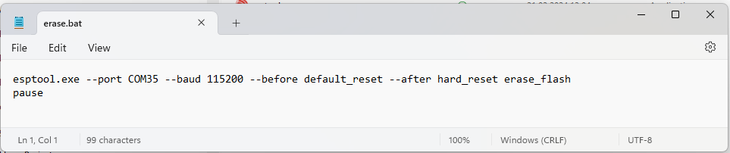
2.2. Flash memory erase
Open the FW_binary folder.
Open the erase.bat file for editing, and change the port number to the value remembered from the previous step.
Run the erase.bat, and check its outputs, there should be no errors reported.

Slide 9
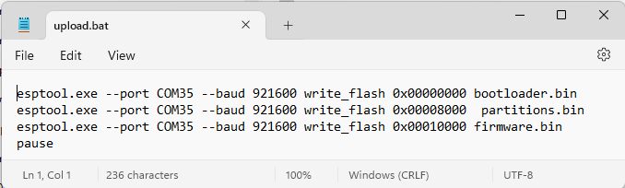
2.3. Installing the Firmware
Open the FW_binary folder.
Open the upload.bat file for editing, and change all port numbers to the value remembered from the previous step.
Run the upload.bat , and check its outputs, there should be no errors reported.
The device should start operating immediately after flashing is completed.

Slide 10
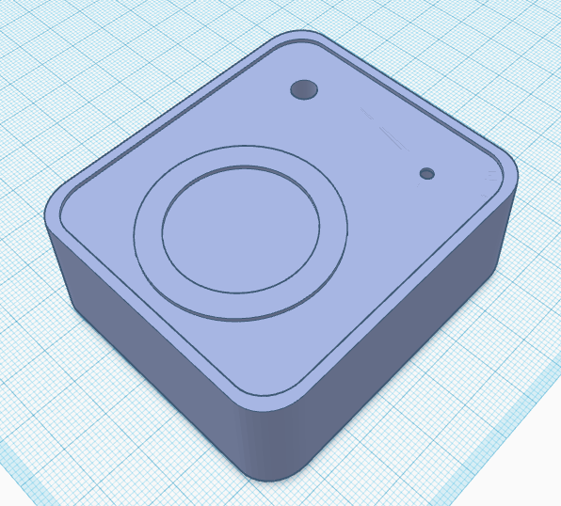
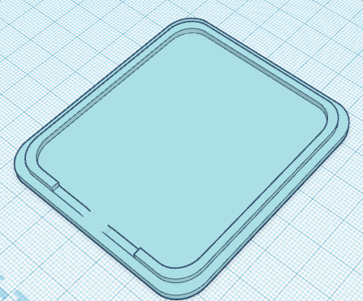
3. 3D printing
Top part (NFC_top.stl)
Bottom part (NFC_top.stl)
Print it in this position with supports

Slide 11
4. Assembling

Slide 12
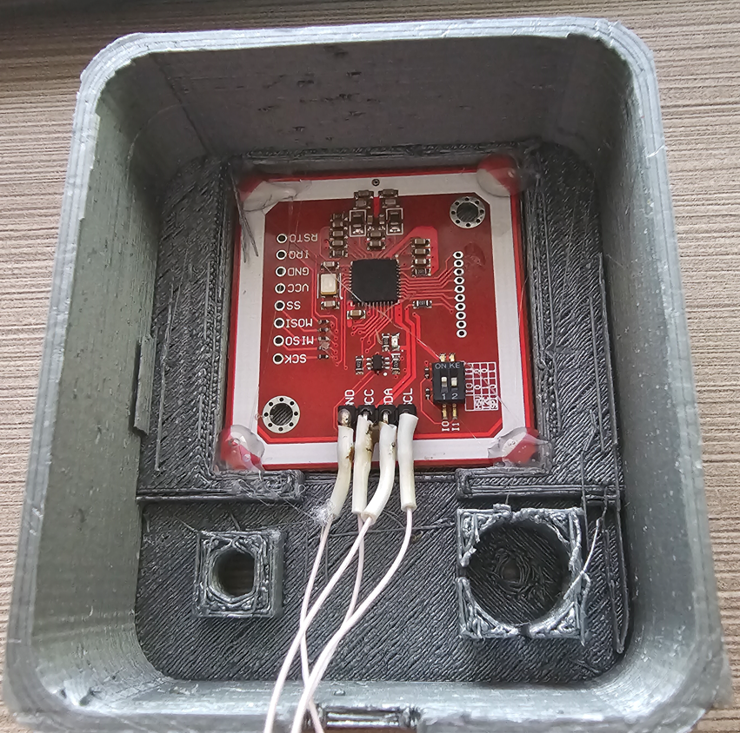
4.1. PN532 module
Tightly insert the PN532 module to the square place as it’s shown;
Check if there are no obstacles between the module and the enclosure, the surface of the module should be tightly pressed to the enclosure;
Add hot stick glue in the corners as it’s shown by arrows;
Hold the module until the glue hardens.

Slide 13
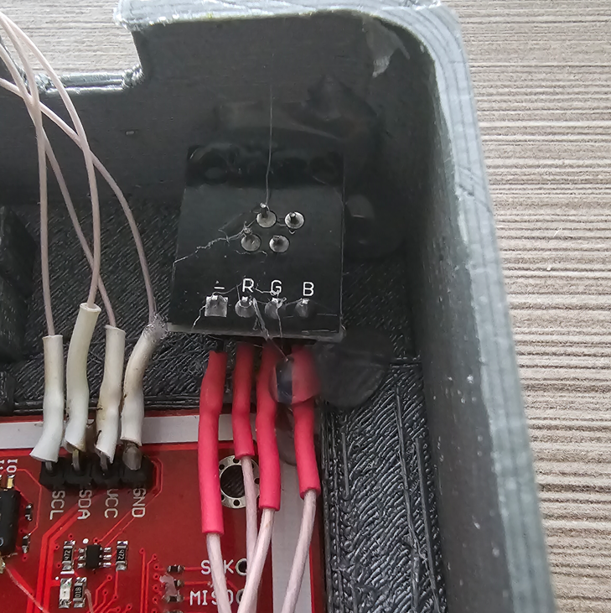
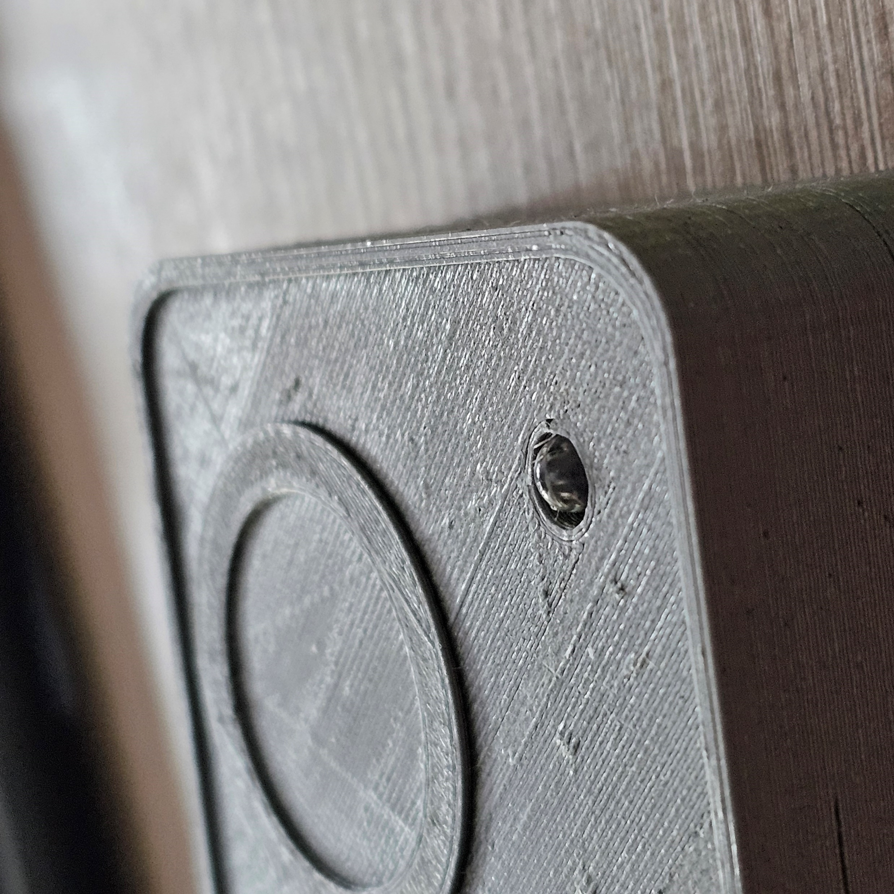
4.2. RGB LED module
Tightly insert the RGB module into the LED holder as it’s shown;
Check how it fits on the top side of the housing;
Add thermal glue in the places as it’s shown;
Hold the module until the glue hardens.

Slide 14
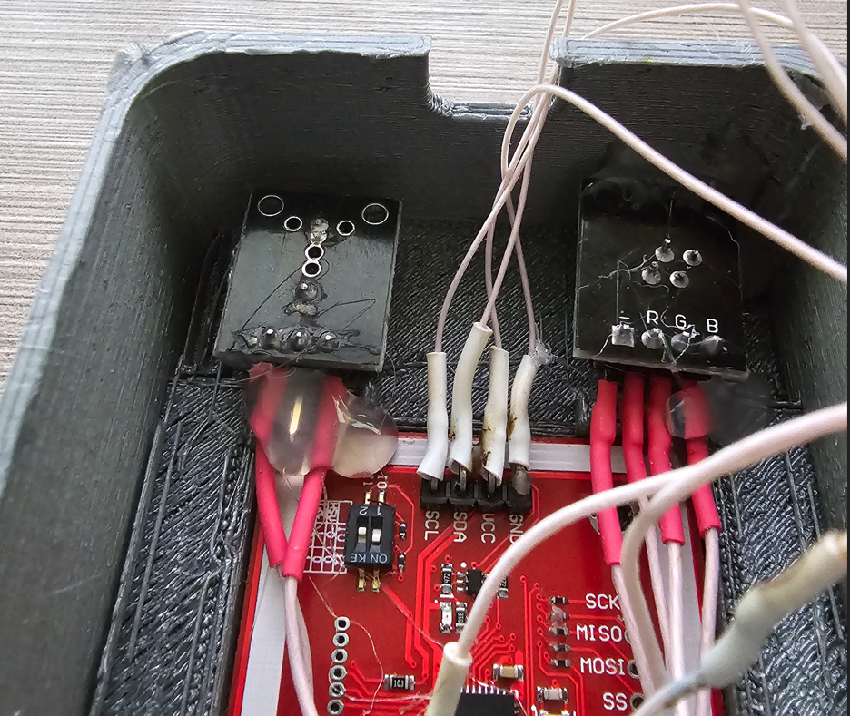
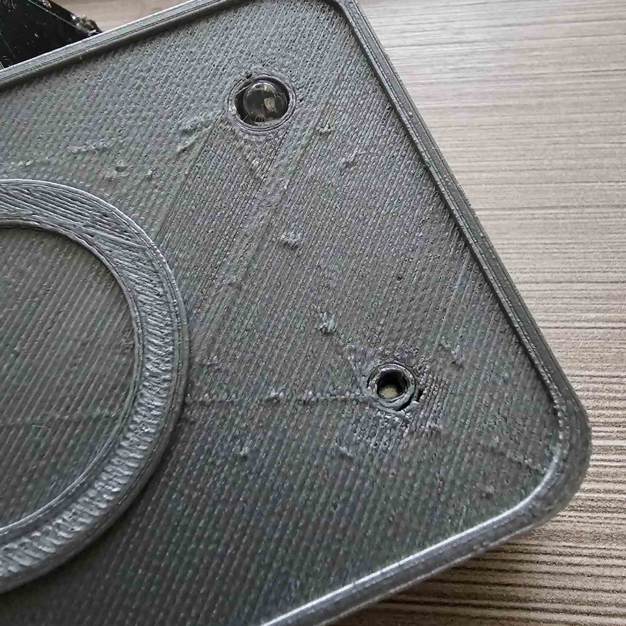
4.3. Buzzer
Tightly insert the Buzzer module into the Buzzer holder as it’s shown;
Check how it fits on the top side of the housing – the membrane should be visible through the hole (see the second picture);
Add thermal glue in the place as it’s shown;
Hold the module until the glue hardens.
Buzzer’s membrane is visible in the hole

Slide 15
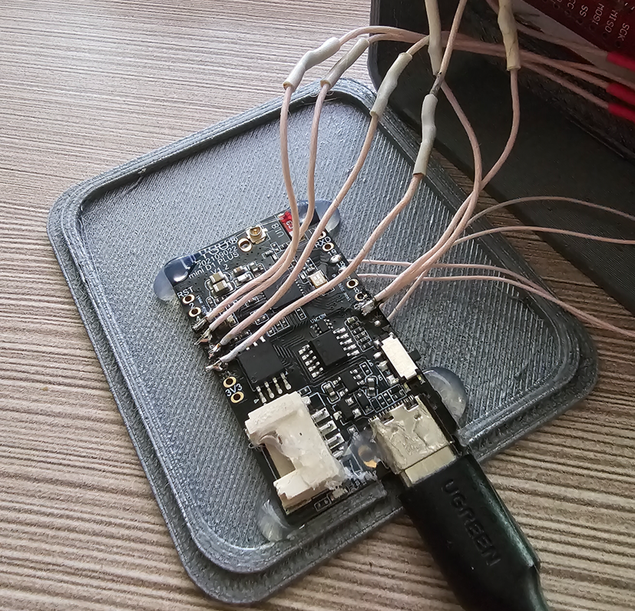
4.4. ESP32 Board
Connect the USB cable to the ESP32 board* (it’s required for height positioning).
Stick the ESP32 board to the bottom part of the enclosure: hot stick glue or thick double-sided tape may be used. The ESP32 board should be placed in a position where USB connector is in the center. Please test how the housing is closing with all components instead USB cable connected before gluing the ESP32 board.
* The ESP32 board which is shown here is of a different model, but the idea of assembling is the same

Slide 16
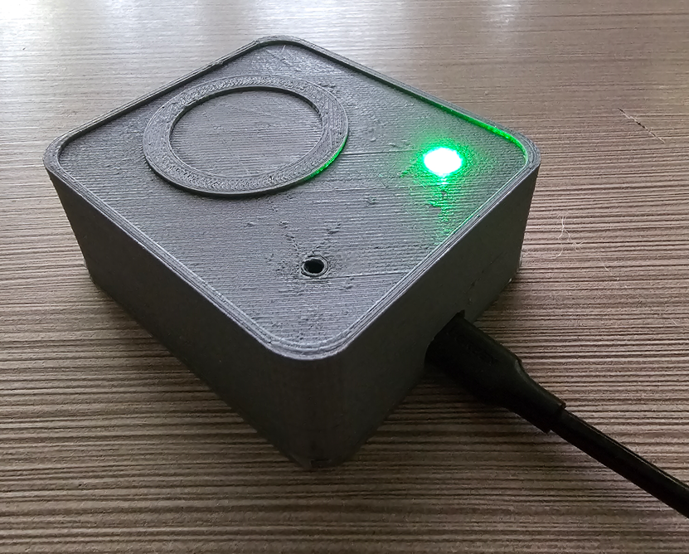
4.4. Final assembling
Connect the NFC reader to a PC; check if it works;
Add several drops of any instant gel glue to the side of the bottom part;
Tightly connect both parts of the housing and wait for gluing.

Slide 17
5. User manual
Connect the NFC reader to the PC, and wait for its boot: RGB color scanning, a single beep.
Check if the device is ready for scanning: solid green LED lights.
Scan the NFC tag: put it in the scanning area and wait for the beep sound. Check if the text record arrived at the Serial port.
Troubleshooting:
- if the device is constantly beeping and blinking red after it’s connected to the PC – reconnect it. If it does not help after 2-3 attempts – this means that PN532 module is not recognized and wiring should be checked.
- if the device beeps three times and blinks red when NFC tag is scanned – the tag was removed before it was read, scan it again.
Scanning area

